Slide 1
SPEECH RECOGNITION IN PYTHON

Slide 2
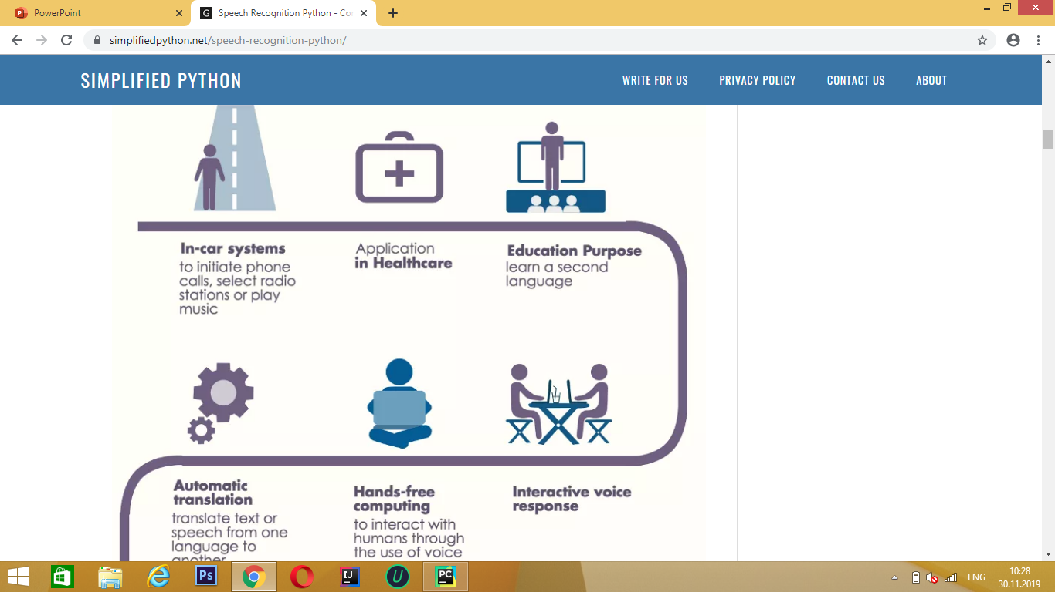

Slide 3
HOW TO DOWNLOAD SPEECH RECOGNITION IN PYTHON FOR WINDOWS
1.First step
OPEN PYTHON TERMINAL
Print – Pip install SpeechRecognition
2.Second step
Print – Pip install pipwin
3.Third step
Print – pipwin install pyaudio

Slide 4
Problems
Python versions
Noise

Slide 5
Usage of Speech Recognition
ვებსაიტის გახსნა
დაგუგლვა
ვოისის გარდაქმნა ტექსტად

Slide 6


Slide 7
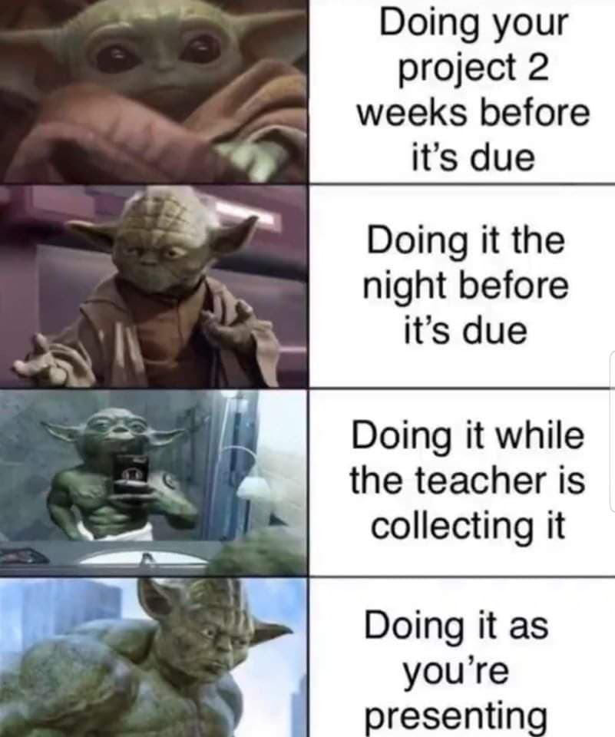
Credits to
Saba Momtselidze

Slide 8
Group members:
Tazo janelidze
Saba tchotchua
Giorgi bilanishvili
Sandro martiashvili
Mariam phavlenishvili

